Slide 1

Introduction to Question #3

Slide 2
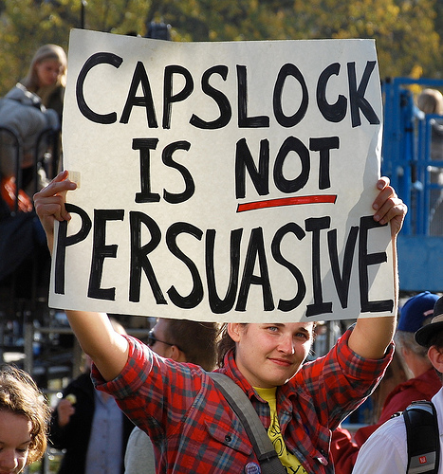
Question 3: Persuasive
Unlike the other two essays you will be asked to write, this essay does not provide any text other than the prompt. Instead, your thesis is supported by your own reading, observations, and experiences.
In other words, this essay’s only support is you; what you “know” is the textual support. This essay can be difficult, as the question, regardless of what it is, presupposes that you have knowledge about the topic under discussion.
The more you’ve learned about the world around you, and the more opinions you have formulated about it, the better.

Slide 3

Persuasive Essay Overview
The language of the actual prompt may vary, but the task remains very similar. You may be asked to:
  Defend, challenge, or qualify a quotation about, or particular take on, a specific topic.
  Take a position of whatever debatable statement is provided in the prompt.
  Evaluate the pros and cons of an argument and then indicate why you find one position more persuasive than another.

Slide 4

Argument
Definition 1: An emotional, verbal fight in which people become angry, bitter, or dissatisfied with the person that you are opposing.
Definition 2: A stance taken in support of an issue that can be supported, verified, or upheld by others.
Screaming is not valid support.

Slide 5
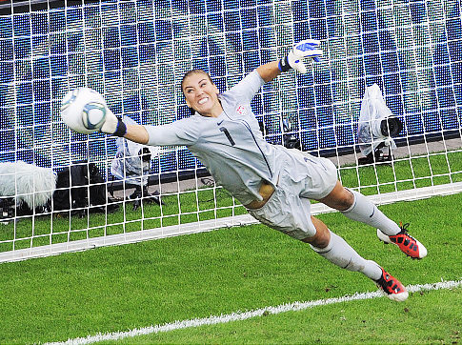
Defend, Challenge, Qualify
If you choose to defend what the text argues, you will give reasons that support the argument given.
If you choose to challenge what the text argues, your reasoning will contradict the argument.
If you choose to qualify what the text argues, you will agree with parts of the statement and disagree with others. Or, you might agree with the statement, but only under certain circumstances.
Hope Solo contends defense wins championships.

Slide 6
Defend, Challenge, Qualify
Defend: You agree with and support the argument presented. You are a proponent and on the affirmative side.
Challenge: You disagree with the argument presented and refute it. You are an opponent and on the negative side.
Qualify: You agree with part of the argument, but also see substantial flaws in logic. This is not the same as providing a counterclaim.
Defend
Challenge
Qualify

Slide 7

Qualify
According to AP readers students have the most difficulty when choosing to qualify an argument.
The nuance required in an qualified argument is often extremely challenging in a timed situation.
Often students make a very entry-level misunderstanding such as “Sontag is not qualified to discuss photography or art.”

Slide 8
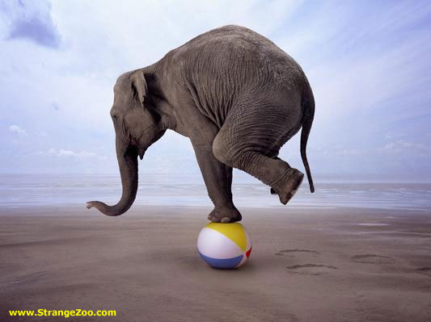
Qualify
Balance can be very difficult to achieve.
However, our recommendation is that every student attempt one qualification essay during second trimester in order to get feedback.

Slide 9

Moral of Story? Pick a Side.
Just to reiterate a final time:
Students are usually better off choosing to “defend” or “challenge” an argument.
You do want to address the opposing viewpoint, but usually it is best to do that in a counter-claim paragraph.

Slide 10

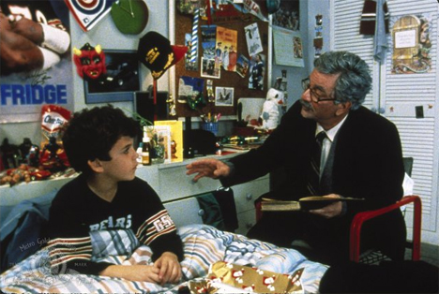
Other “Technical” Terms
  Evidence is a piece of information that supports a claim
    Hard Facts
    Quotes
    Stats/Data
  Examples are types of evidence and come in the form of
    Personal Experience
    Analogies
    Logical Hypotheticals

Slide 11
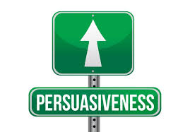
Going Somewhere?
  Developing an argument means the argument needs to move forward
    You can’t just make one little point and assume you are developing it by adding six redundant examples
    Several well-ordered claims (points) give your argument a dynamic sense of movement.

Slide 12
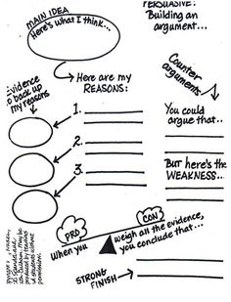
Introduction Paragraph
  Hook
    Attention getter. Use an appeal.
  Background
    Consider your audience and provide background information they are likely to need.
  Thesis (claim)
    Clearly state your position and preview the claims (points).

Slide 13

Supporting Paragraphs
    State your supporting claim
    Back it up with evidence and examples.
    Make it impactful by explicitly relating supporting points back to the thesis.
    At some point you will need to acknowledge the other side. Ideally, this is through the use of a counter-claim paragraph.

Slide 14
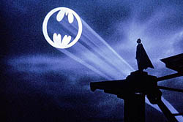
conclusion
Include a Call to Action
  Review your thesis and major body points
  Leave your audience with a lasting impression

Slide 15
Common Errors
Not taking a clear position or wavering between positions.
Substituting a thesis-oriented expository essay for an argumentative essay. You need to persuade, not just inform.
Being reluctant to engage in verbal combat because "everyone's entitled to his or her own opinion," so there's nothing to argue about.
Discussing details too generally. There is power in specificity.
Lacking clear connections between claims and the data, and the warrants needed to support them
Providing a rhetorical analysis of the passage or commenting on the speaker’s style instead of arguing a point

Slide 16

Chief Reader on Understanding the world Around You.
“Through extensive reading, discussion, and writing, students will come to recognize a world larger than their own immediate experience.
…Teachers need to help students understand the usefulness of a global view, to increase their awareness of the world beyond their own. Students need to recognize that examples drawn from a wider world may be stronger [than their own personal experiences]
...When relating their personal experiences, students need to be mindful of the public nature of most argumentation. In such a context, the primary purpose of a personal narrative is rhetorical, not confessional.”

Slide 17
Today’s Prompt
Question 3
(Suggested time—40 minutes. This question counts for one-third of the total essay section score.)
In his 2004 book, Status Anxiety, Alain de Botton argues that the chief aim of humorists is not merely to entertain but “to convey with impunity messages that might be dangerous or impossible to state directly.” Because society allows humorists to say things that other people cannot or will not say, de Botton sees humorists as serving a vital function in society.
Think about the implications of de Botton’s view of the role of humorists (cartoonists, stand-up comics, satirical writers, hosts of television programs, etc.). Then write an essay that defends, challenges, or qualifies de Botton’s claim about the vital role of humorists. Use specific, appropriate evidence to develop your position.

Slide 18
Baseline Prompt
Background: For years corporations have sponsored high school sports. Their ads are found on the outfield fence at baseball parks or on the walls of the gymnasium, the football stadium, or even the locker room. Corporate logos are even found on players’ uniforms. But some schools have moved beyond corporate sponsorship of sports to allowing “corporate partners” to place their names and ads on all kinds of school facilities—libraries, music rooms, cafeterias. Some schools accept money to require students to watch Channel One, a news program that includes advertising. And schools often negotiate exclusive contracts with soft drink or clothing companies.
Prompt: Some people argue that corporate partnerships are a necessity for cash-strapped schools. Others argue that schools should provide an environment free from ads and corporate influence. Using appropriate evidence, write an essay in which you evaluate the pros and cons of corporate sponsorship for schools and indicate why you find one position more persuasive than the other.

Slide 19
Prompt
Some people argue that corporate partnerships are a necessity for cash-strapped schools. Others argue that schools should provide an environment free from ads and corporate influence. Using appropriate evidence, write an essay in which you evaluate the pros and cons of corporate sponsorship for schools and indicate why you find one position more persuasive than the other.

